Slide 1
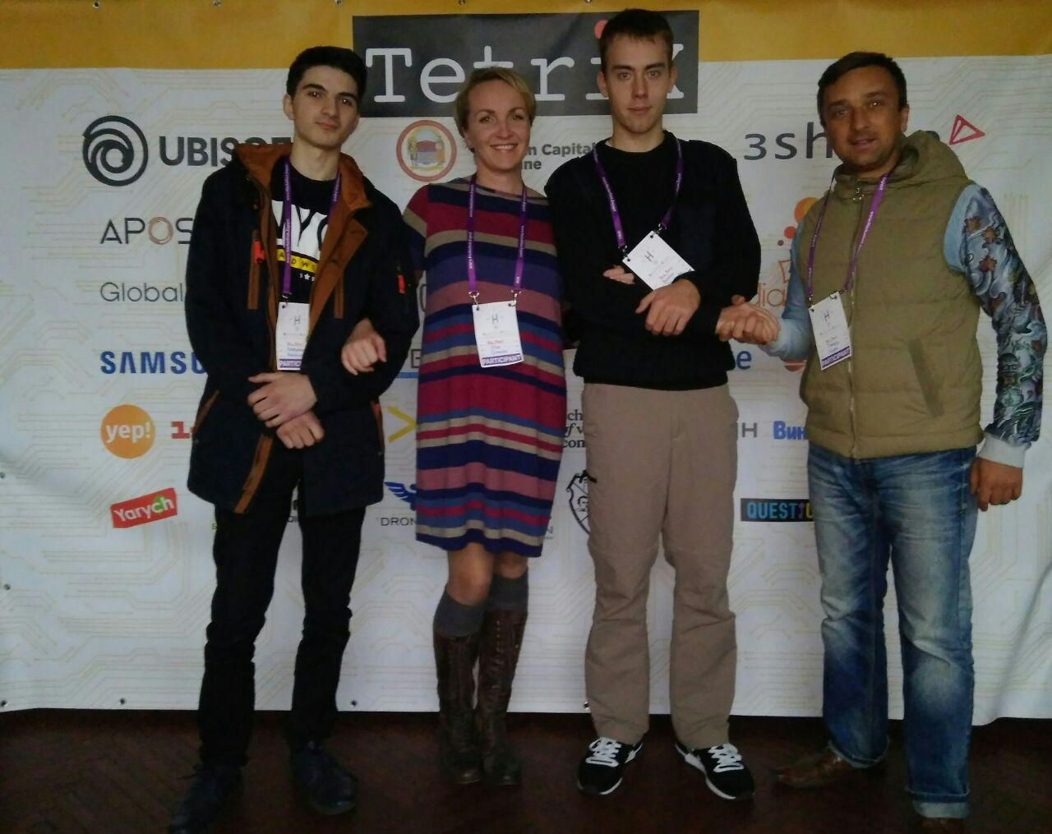


Команда Yes, bro!
Yevgeniy
Sergey
Bogdan
Rostislav
Olga

Slide 2


We facilitate your business start​

Slide 3
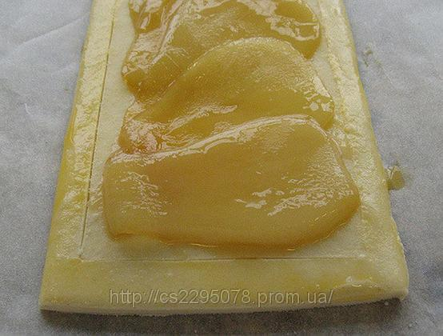

ДО ПОСЛЕ

Slide 4
Let’s try with our service
We facilitate your business start
Just take an image and start selling
Use our API for automatic access to the base
Use service in educational programs – investment to the future!
Free access for Non-profit organization
Wiki image base.

Slide 5
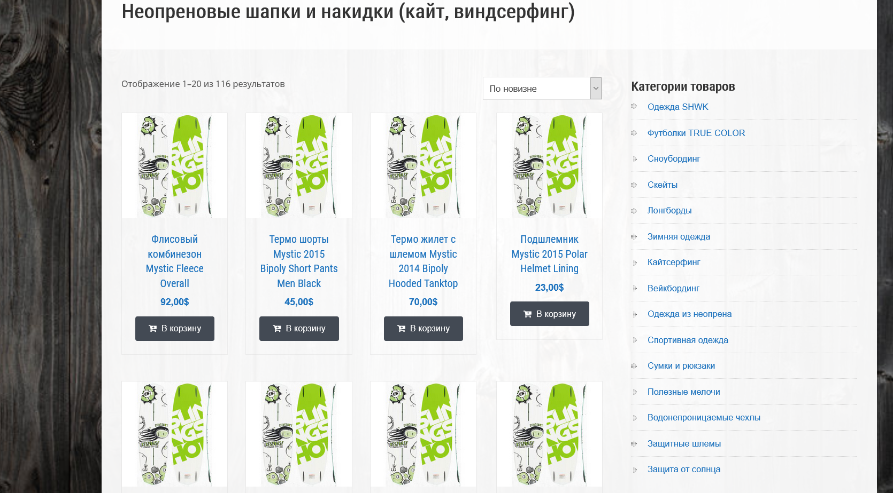
DON’T do like this

Slide 6
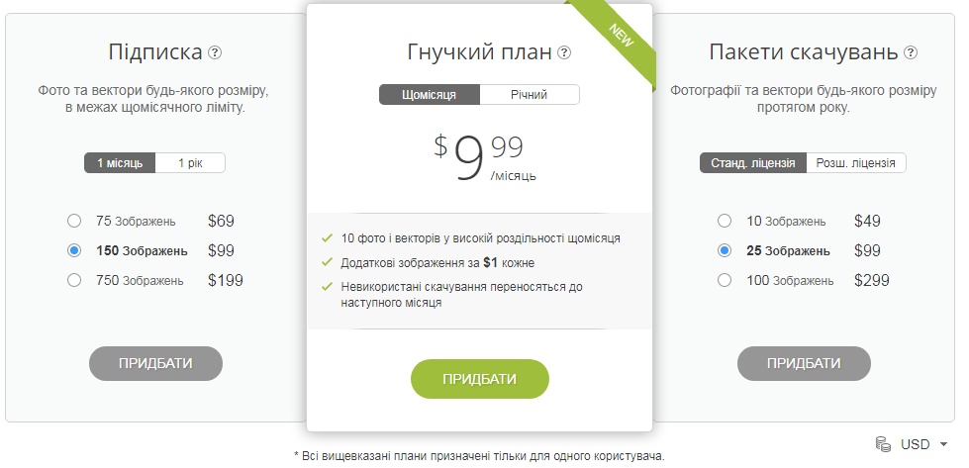

Slide 7
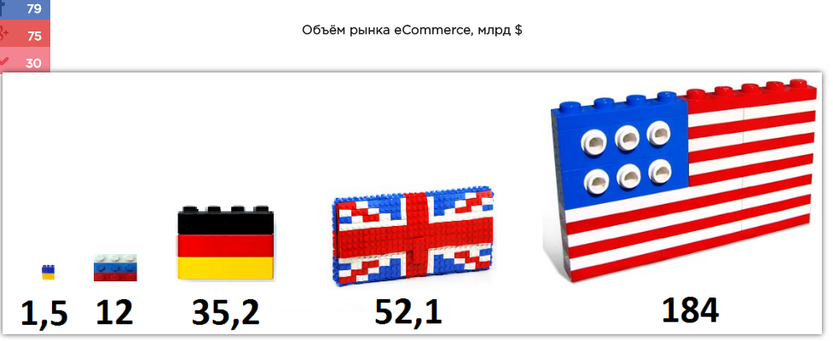

Slide 8
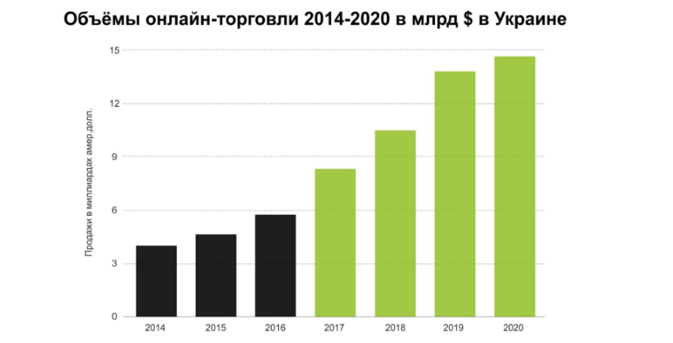
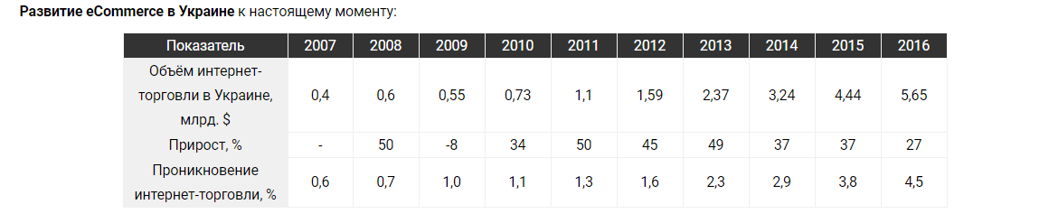

Slide 9
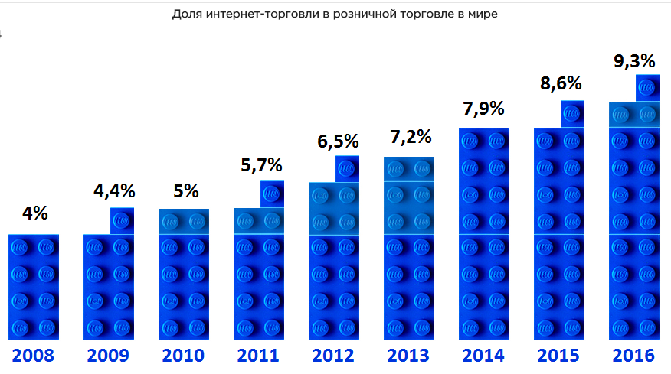

Slide 10
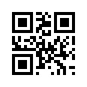

Thank you

